Slide 1
Quality monitoring assessment of mortality at VA hospitals performing Cardiac Procedures
Bridget Balkaran
BIOS 6623 Project 2
Final Presentation

Slide 2
Research question and Summary of Data
 | N | No. Missing | Recent six month period (39) | N | No. Missing | Past 3 Years
Mortality, n (%) |  | 0 |  |  | 0
Yes |  |  | 145 (3.28) |  |  | 868 (3.27)
No |  |  | 4279 (96.72) |  |  | 25650 (96.73)
Procedure, n (%) |  | 103 |  |  | 549
CABG |  |  | 3507 (79.27) |  |  | 20908 (78.84)
Valve |  |  | 814 (18.40) |  |  | 5061 (19.09)
ASA category |  | 115
low ** |  |  | 1063 (24.03) |  |  | 6296 ( 23.74)
high ** |  |  | 3246 ( 73.37) |  |  | 19558 (73.75)
BMI, median (Q1, Q3) | 4212 | 212 | 27.12(20.80, 30.49) | 25816 | 702 | 28.50 (25.67, 31.19)
Albumin, median (Q1, Q3) | 2240 | 2184 | 3.99 (3.63, 4.36) | 13279 | 13239 | 4.00 (3.64, 4.37)
Height*, median (Q1, Q3) | 4226 | 212 | 65.51 (63.87, 67.23) | 25816 | 702 | 65.49 (63.78, 67.23)
Weight*, median (Q1, Q3) | 4212 | 198 | 165.14 (124.38, 188.87) | 25911 | 607 | 174.31 (154.82, 192.82)
How do death rates from cardiac procedures at VA hospitals in the last six month period compare to adjusted expected values from the last 3 years?
Similar distributions of variables except weight
should not affect analysis since BMI was recalculated
Percentages similar for categorical variables
All weight height and BMI values missing for hospital 30 in the last six month period

Slide 3
Analysis Plan
Data Cleaning – procedure 2, correcting weights, recalculating BMI, collapse ASA
Missing Data analysis– Albumin missing 50% of data
Albumin data MAR based on ASA. Theoretically should not result in biased estimates but could produce bias in estimates since ASA is related to mortality
PROC LOGISTIC
Primary model: model mortality with procedure, categorical ASA, and BMI – generate adjusted expected death rate for period 39
Model with albumin: model mortality with procedure, categorical ASA, BMI, and albumin – generate adjusted expected death rate for period 39
Calculate observed death rates for period 39
Compare observed death rate to adjusted rates for each hospital to determine if any action needs to be taken or if policies can be applied to other hospitals to improve mortality outcomes (threshold of 20% change is of concern)

Slide 4
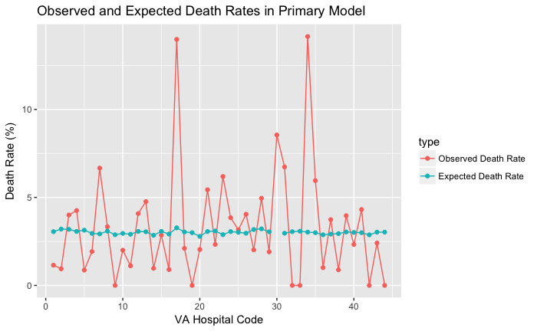
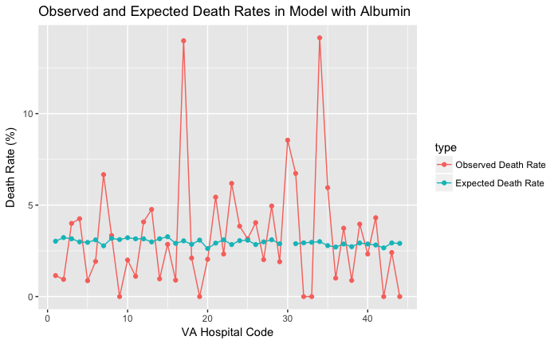
Observed and Adjusted Expected Death Rates by Hospital
Figure 1. Observed and Adjusted Expected Death Rates in period 39 in the Primary Model and the Model with Albumin. *Note connecting lines are not pictured to show trend, but to ease the alignment of points for the reader.
Not much difference observed between looking at the data crudely

Slide 5
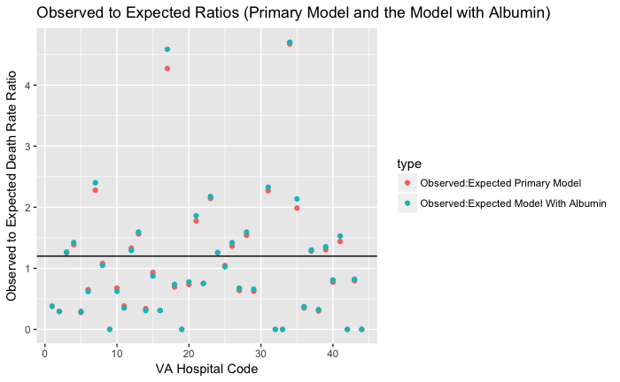
Percent Change of Observed to Expected Death Rate Ratios in Primary Model and Model With Albumin
For those with a higher than a 20% change in the observed and expected death rates, the models do not seem to line up and give the same ratio which could indicate some level of bias.
Points overlap more under a 20% change than over a 20% change
17 hospitals has a percent change of 20% or more
Figure 2. Observed to Expected Ratios. Percent Change Comparisons Between Observed and Expected Death rates in the Primary Model and the Model with albumin.

Slide 6
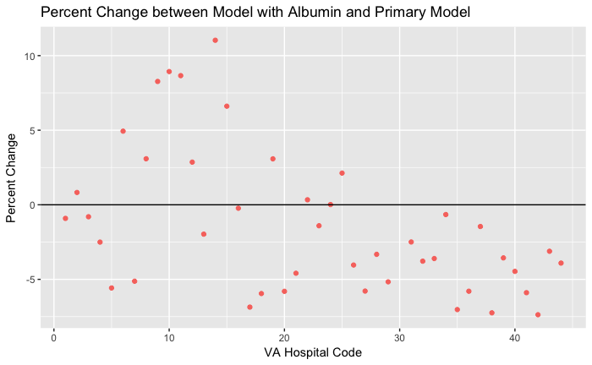
Percent Change Between Expected Death Rate in Primary Model and Expected Death Rate in the Model with Albumin
% change (expected death rate with albumin model – expected death rate primary model) / expected death rate in the primary model x 100
Values above the line indicate positive percent change or percent increase showing that the expected death rates for the model with albumin was larger than the expected death rate for the primary model.
Values below the line show that the expected death rates of the model with albumin are smaller than the expected death rates in the primary model.
For hospitals whose percent change is positive (above the black line) there could be some bias in the model with albumin since these expected death rates yield larger values.
If hospitals that have higher expected death rate values from the model with albumin (values are above the black line), then perhaps hospitals that adjusted for albumin had patients that were more likely to die, resulting in a higher death rates with albumin in the model.
This could be due to the fact that sicker individuals (higher ASA values) were more likely to have albumin data which would bias the results away from the null.
Figure 3. Percent Change of Expected Death Rate in Primary Model and Expected Death Rate in the Model with Albumin.

Slide 7
Conclusions and Limitations
In some hospitals, the model with albumin may have biased results since those who are sicker are more likely to have albumin data and those that are sicker are at a higher risk of mortality.
In further reports it would be interesting to collect albumin data on all patients to see if expected values are truly different for primary models and models with albumin.
In terms of which hospitals should be visited, the 17 hospitals with a greater than 20% change between observed and expected death rates may want to be looked at further
hospitals 17 and 34 seemed to have the highest death rates in both models and this may need to be addressed by hospital administration.
For hospitals that are doing well in keeping mortality down, VA administration may be interested in visiting hospitals 9, 19, 32, 33, 42, and 44 to see how they are working to improve mortality outcomes after cardiac procedures.
These methods may be useful to implement in other VA network hospitals to help keep mortality low.
A strength of this study is the availability of past years’ data to calculate adjusted values to have better means of comparing observed and expected death rates.
A limitation of this study is that although the observed and expected death rates can be calculated and observed we cannot be sure any change are statistically significant as we cannot assume our population is normally distributed. In further studies, performing a bootstrap to generate confidence intervals would be beneficial to see if changes between observed death rates and expected death rates are significant.

